Slide 1
CS 408
Computer Networks
Chapter 06
Transport Protocols

Slide 2
Transport Protocol - Summary
Provides end-to-end data transfer
Shields upper layer application protocols from the details of networks
TCP: complicated flow and error control since the underlying network service (IP) is unreliable
TCP is connection oriented
UDP is another transport layer protocol but connectionless

Slide 3
Connection Oriented Transport Protocol Mechanisms
Logical connections between end users
  Connection Establishment
  Data Transfer
  Connection Termination
Reliable service
e.g. TCP

Slide 4
Reliable Sequencing Network Service
TCP is complex because of IP, which is unreliable
Let’s assume the underlying network service is reliable (for simplicity)
  frame relay (LAPF control protocol)
  802.3 LAN with connection oriented LLC
Slides until 19 discuss Transport Layer issues under this reliable network layer assumption
  After that we will discuss what happens when the network layer is unreliable

Slide 5
Issues in a Simple Transport Protocol
Addressing
Multiplexing
Flow Control
Connection establishment and termination

Slide 6
Addressing and Multiplexing
Multiple users employ same transport protocol
  Users are multiplexed
  User is locally identified by port number
User identification for the target
  Usually host address + port
    Called a socket in TCP and UDP
Port represents a particular transport service (TS) user
  25 SMTP, 80 HTTP, etc. -> these are for server
  Client port numbers are >1024 and selected arbitrarily
Host address
  An attached network device
  In the Internet, a global internet address (e.g. IP addr.)

Slide 7
Flow Control
Flow should be controlled because
  The receiving party may not keep up with the flow of data
  Results in buffers filling up
Transport level flow control is more difficult than link-level one
  transmission delay is variable due to network. That makes difficult to use timeouts

Slide 8
Transport Level Flow Control
Do nothing
  Segments that overflow are discarded
  Sending transport entity will fail to get ACK and will retransmit
    Not a good solution for a reliable network
Backpressure
  Refuse further segments
    So that the sending party eventually senses the problem due to lengthy queues
  Coarse grained
    Network and link layer connection are used by several transport layer connections and flow control is exercised on several transport connections together
Sliding window protocols with credit scheme
  Similar to sliding window protocols of data link layer
    Sender sends up to certain window size without getting ack
    However, here, window size is set dynamically and unit is octets

Slide 9
Credit Scheme
Decouples flow control from ACK
  May ACK without granting credit and vice versa
Each octet has an implicit sequence number
Each transport segment has a header that contains
  sequence number
  ack number
  window size

Slide 10
Use of Header Fields
When sending
  seq. number (SN) of first octet in segment is included
Two flow control related fields: AN=i, W=j
  AN is ack. number; W is window size (for credit)
  All octets with sequence numbers up to and including i-1 are acknowledged
    Next expected octet is i
  Permission to send window of W=j octets (gives credit)
    i.e. octets up to and including i+j-1
    Not to be added to the remaining credit
    Credit is not automatically refilled with acks.

Slide 11
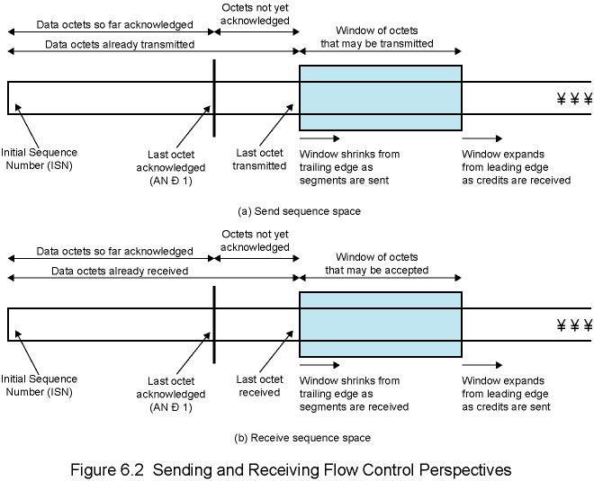
Flow Control Perspectives of Sending and Receiving Parties
-
-

Slide 12
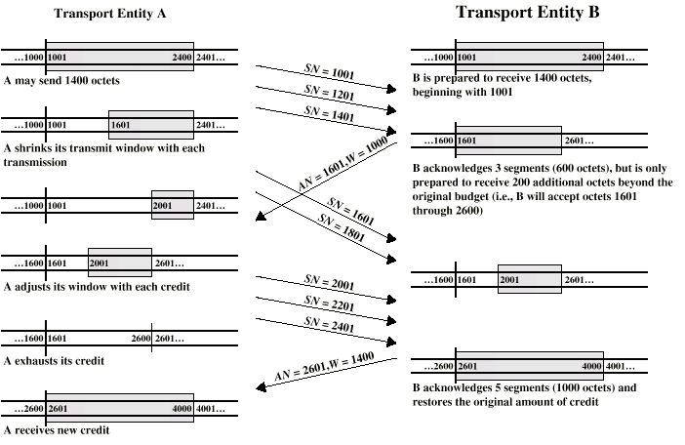
Example of TCP Credit Allocation Mechanism
- Assume 200 octets/segment
- Initial credit 1400 octets
- Beginning octet number 1001
Notes:
Assume 200 octets/segment
Initial credit 1400 octets
Beginning octet number 1001

Slide 13
Connection Establishment and Termination
Necessary even with a reliable network services
Purposes
  Allow each end user to know the other exists and is willing to communicate
  Negotiation of optional parameters
  Triggers allocation of transport entity resources
Connection establishment is by mutual agreement
  control messages are exchanged

Slide 14
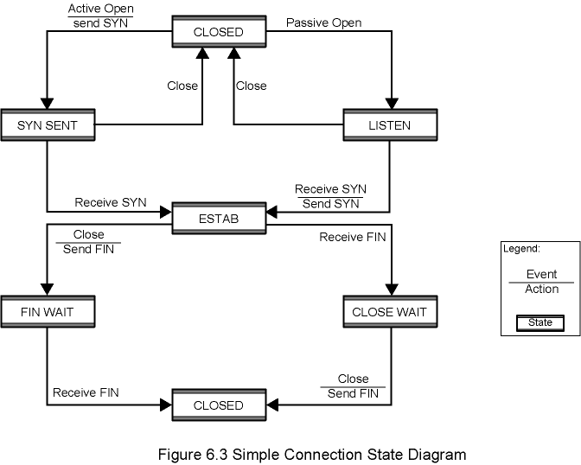
Figure 6.3 Simple Connection State Diagram

Slide 15
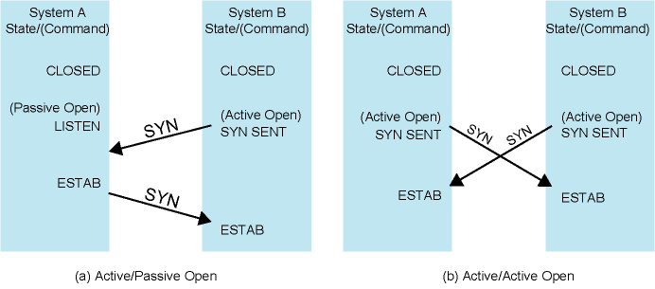
Figure 6.4 Connection Establishment Scenarios

Slide 16
Termination
Either side may initiate termination
Abrupt or Graceful
Abrupt termination
  Data in transit may be lost
Graceful termination
  By mutual agreement
  Connection is not closed until all data in transit delivered
  Figure 6.3 shows the state diagram

Slide 17
Side Initiating Termination
Transport layer user (upper layer) issues Close request
Transport entity sends FIN, requesting termination
Connection placed in FIN WAIT state
  Continue to accept data
  Do not send any more data
When FIN received, inform user and close connection

Slide 18
Side Not Initiating Termination
When FIN received
  Transport entity informs its user (upper layer) and place connection in CLOSE WAIT state
    Continue to transmit data as received from its user (upper layer)
When the user of transport entity issues CLOSE primitive
  Transport entity sends FIN
  Connection closed
This procedure ensures that
  both sides received all outstanding data
  both sides agree to terminate
  Thus, graceful termination

Slide 19
Unreliable Network Service
For examples
  internet using IP,
  IEEE 802.3 using unacknowledged connectionless LLC
Segments may get lost
Segments may arrive out of order
Solutions will create other problems

Slide 20
Problems
Ordered Delivery
Retransmission strategy and setting timer values
Duplication detection
Flow control
Connection establishment
Connection termination

Slide 21
Ordered Delivery
Segments may arrive out of order
General solution: number data units sequentially and reorder the segments accordingly
TCP numbers each octet sequentially
  implicit numbering
  Segments are numbered by the first octet number in the segment
  The length of the segment is also known
  Thus we know the sequence number of the next in-order segment

Slide 22
Retransmission Strategy
Segment may be damaged while in transit
Segment may fail to arrive
Transmitter may not know of failure
Positive acknowledgment: receiver must acknowledge successful receipt
  No negative acknowledgments in TCP
Cumulative acknowledgment can be used
  several segments can be acknowledged in one ack message
Waiting ACK for a long period of time (timeout period) triggers re-transmission

Slide 23
Timer Value
Fixed timer
  Based on typical network behavior
  Cannot adapt to changing network conditions
  “Too small” leads to unnecessary re-transmissions
  “Too large” causes slow response to lost segments
  Should be a bit longer than rtt, round trip time (but rtt is not fixed)
Adaptive scheme: based on average round-trip delay. But this mechanism also has problems
  May not ACK immediately (cumulative ack)
  Conditions may change suddenly
No complete solution but there are some heuristics
  that will be covered in the last week lectures

Slide 24
Duplication Detection
If segments are lost and retransmitted, no problem
If ACK lost, segments are retransmitted
  Original one may arrive after the retransmitted one
  Receiver must recognize duplicates
Duplicate received prior to closing connection
  Receiver assumes that ACK is lost and sends ACK for the duplicate
  Sender must differentiate these two cases: (i) multiple ACKs for the same segment and (ii) new segment with the same seq. number
  Sequence number space must be large enough in order not to cycle within maximum lifetime of a segment (see the next slide for an example case why this is needed)
Duplicate received after closing connection
  Discussed a bit later

Slide 25
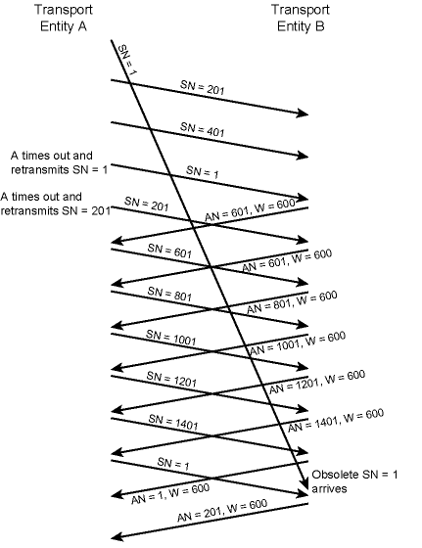
Example of
Incorrect
Duplicate
Detection
Sequence space is 1600
credit window size is 600
Legitimate new segment with SN=1 is discarded wrongfully

Slide 26
Flow Control
Credit allocation scheme is quite robust and flexible for the unreliable case
  it is possible to increase credit without ack
    after (AN = i, W = j), send (AN = i, W = k), k > j
  it is possible to ack without extra credit
    after (AN = i, W = j), send (AN = i + m, W = j - m), where m is acked segment length
Lost ACK/CREDIT is generally no problem
  future acks resynchronize the protocol
  lost ack causes timeout and retransmission
  retransmission triggers ack
  but deadlock is still possible

Slide 27
Flow Control
Possible deadlock case
  receiver temporarily closes window with AN=i, W=0
  later reopens with AN=i, W=j, but this is lost
  Sender thinks window is still closed, receiver thinks it is open
  SOLUTION: use window timer
    a timer is employed for each outgoing ACK/CREDIT segment
    timer expires if no new ACK/CREDIT segments are sent within the timeout period
    if timer expires, retransmit the previous ACK/CREDIT segment

Slide 28
Connection Establishment
Two way handshake
  A sends SYN, B replies with SYN
  Lost SYN handled by retransmissions via some timers
    May cause to duplicate SYNs
  Ignore duplicate SYNs once connected
Delayed data segments can cause connection problems
  Segment from old connections (see next figure)

Slide 29
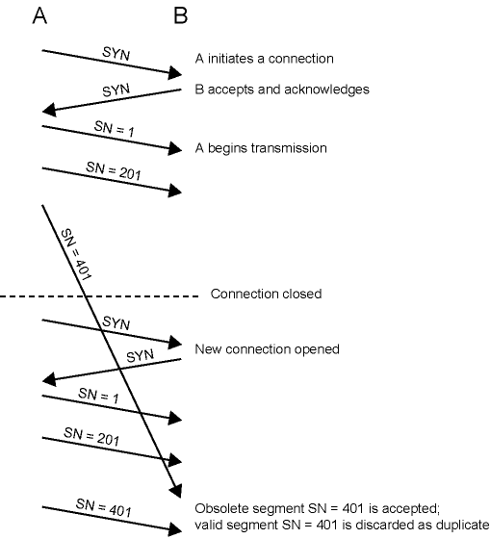
Two-Way
Handshake
Problem with
Obsolete
Data
Segment

Slide 30
Solution to Obsolete Data Segment Problem
First segment number of the new connection must be distant from the last segment number of the previous connection
Need to specify the expected sequence numbers in connection messages
  Use SYN i
  i + 1 is the sequence number of the first segment to be sent on that connection
  acknowledged by SYN j
  j + 1 is the first octet number on the other direction
  New Problem: Obsolete SYN (see next figure)

Slide 31
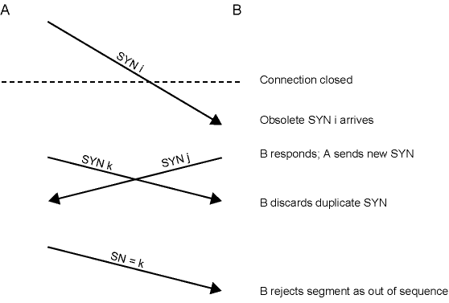
Two-Way Handshake, Problem with Obsolete SYN Segments
+ 1

Slide 32
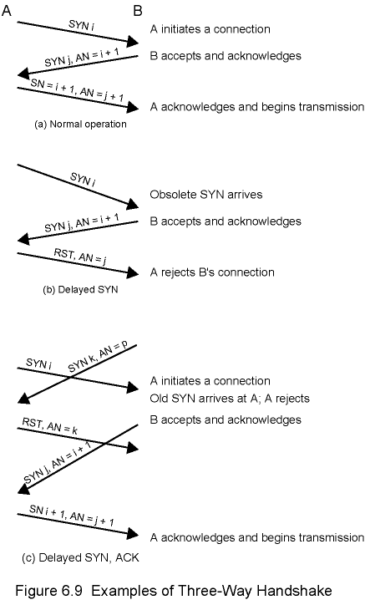
Solution to Obsolete SYN Problem
Acknowledgments should also include the request’s SYN number + 1 (AN=i+1)
Three Way Handshake
  SYN
  SYN-ACK
  ACK (of SYN)
Last message is actually a data segment with ack field is for the SYN of B
obselete
obselete

Slide 33
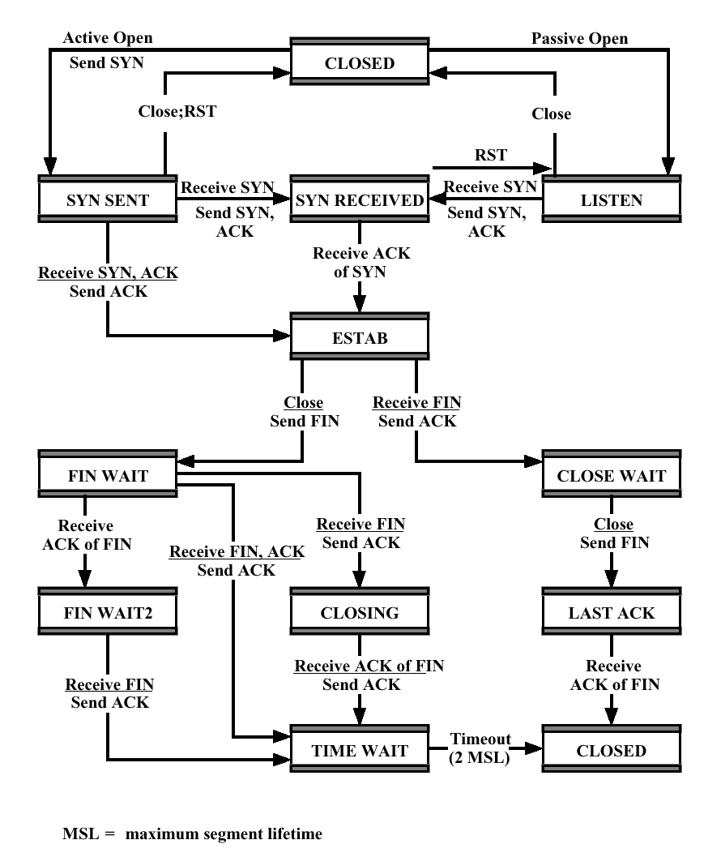
Three Way
Handshake:
State
Diagram

Slide 34
Connection Termination
In two-way handshake (Figure 6.3, slide 13), entity in CLOSE WAIT state sends last data segment, followed by FIN
  FIN arrives before last data segment
  Receiver accepts FIN
    Closes connection
    Loses last data segment
Solution: add sequence number (seq. number of the last transmitted octet) to FIN
Receiver waits for all segments up to and including this sequence number in FIN
  After that it sends ack for FIN
This is repeated for the other way around

Slide 35
Connection Termination
For Graceful close, initiating entity should:
  Send FIN i and receive its ack (AN i+1)
  Receive FIN j and send its ack (AN j+1)
  Wait twice maximum expected segment lifetime. Why?
FIN i
FIN i
AN i+1
AN i+1, FIN j
FIN j
AN j+1
AN j+1
wait
wait
Notes:
Because, final ack may not be received by receiver. If another FIN is received within this period, final ack is retransmitted.

Slide 36
TCP & UDP
Transmission Control Protocol (TCP)
  Connection oriented
  Reliable end to end transport
  RFC 793
User Datagram Protocol (UDP)
  Connectionless
  Not reliable
  RFC 768

Slide 37
TCP Connection Management - 1
Multiplexing
  TCP can simultaneously provide service to multiple processes
  Processes are identified with port
  Port + IP address = socket
  TCP logical connection is between two sockets

Slide 38
TCP Connection Management – 2
Connection Establishment and Termination
Connection Establishment
  Set up logical connection between two sockets
  Connection between two sockets may be set up if:
    No connection between these sockets currently exists
    Internal TCP resources (e.g., buffer space) are sufficient
    Both users agree
Termination is either abrupt or graceful
  Abrupt termination may lose data
  Graceful termination prevents either side from shutting down until all outstanding data have been delivered

Slide 39
Special Capabilities
Data stream push
  Normally, TCP buffers data until enough data available to form segment while sending
    Similarly buffers data at reception instead of bugging upper layer protocol for each segment received
  Push flag requires transmission of all outstanding buffered data up to and including that labeled with a push flag
  Receiver will deliver data in same way
Urgent data signalling
  Tells destination user that significant or "urgent" data are coming
  Destination user determines appropriate action

Slide 40
TCP Service Primitives
Layer-to-layer services are defined in terms of primitives and parameters
Primitive specifies function to be performed
Variety of primitives
  Passive/Active open
  Send / Deliver data
  Close primitives
Parameters pass data and control information
  Ports, IP addresses, data, flags (PUSH, URGENT), etc.

Slide 41
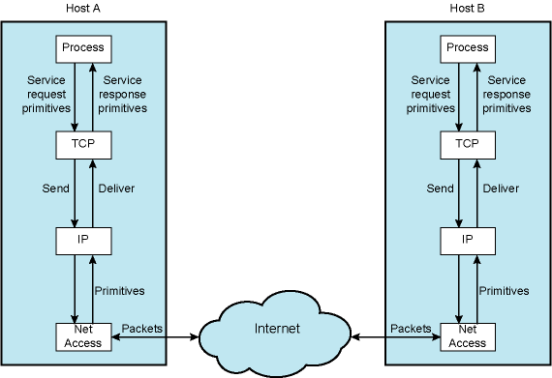
Use of TCP and IP Service Primitives

Slide 42
Basic Operation
Data transmitted in segments
  TCP header and portion of user data
  Some segments carry no data
    For connection management
Data passed to TCP by user in sequence of Send primitives
Buffered in send buffer
TCP assembles data from buffer into a segment and transmits (from time to time)
Segment transmitted by IP service
Delivered to destination TCP entity
Strips off header and places data in receive buffer
TCP notifies its user by Deliver primitive that data are available (from time to time)

Slide 43
Difficulties
Segments may arrive out of order
  Sequence number in TCP header helps to reorder
Segments may be lost
  Sequence numbers and positive acknowledgments
  TCP retransmits lost segments (after timeout)
    Save copy in segment buffer until acknowledged
  No negative acknowledgment in TCP

Slide 44
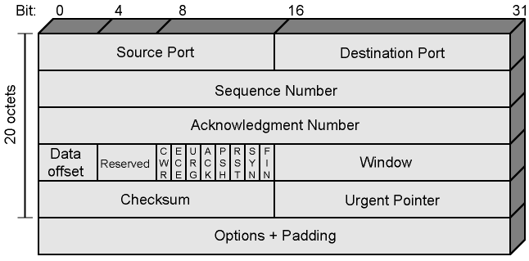
TCP Header

Slide 45
TCP Header
Checksum
  Covers entire segment plus a pseudo header
  Pseudo header contains
    Source and destination IP addresses, protocol, length field of IP header
  Reason to include pseudo header in checksum
    If IP delivers the packet to the wrong host, the receiver will detect the problem
  But protocol independence principle is somehow violated

Slide 46
TCP Options
Maximum segment size
  Included in SYN segment
Window scale (defined in RFC 1323)
  Included in SYN segment
  Window field gives credit allocation in octets (bytes)
  With Window Scale, value in Window field multiplied by 2^{F}
    F is the value of window scale option
Sack-permitted (RFC 2018)
  Selective acknowledgement allowed
Sack (RFC 2018)
  In order to allow the receiver to acknowledge non-consecutive data, so that the sender can retransmit only what is missing at the receiver's end.

Slide 47
Items Passed to IP
Some options that are passed to TCP by upper layer (via primitives and parameters) are not in TCP header
  They are passed to IP and they are included in IP header
  IP addresses
  Basic Quality of Service Parameters related to the network
What is the implicit assumption here? Is that assumption plausible?

Slide 48
Payload Length
Question: What about segment length? It is not in the TCP header. How is the receiver TCP entity be informed about the payload length?

Slide 49
TCP Mechanisms (1)
Connection establishment
  Three-way handshake
  Between pair of sockets
    A socket is IP address and port
  At any given time, there can be a single TCP connection between a unique pair of sockets.

Slide 50
TCP Mechanisms (2)
Data transfer
  Stream of octets
  Octets numbered modulo 2³²
  Segments contain sequence number of the first octet
  Flow control by credit allocation of number of octets
  TCP decides when to construct a segment
    exception is PUSH

Slide 51
TCP Mechanisms (3)
Connection termination
  Graceful close
    TCP user issues CLOSE primitive
    Transport entity sets FIN flag on last segment sent
  Abrupt termination by ABORT primitive issued by TCP user
    TCP entity abandons all attempts to send or receive data
    RST segment transmitted

Slide 52
Implementation Policy Options
Some details up to the implementations
Send policy
Deliver policy
Accept policy
Retransmit policy
Acknowledge policy

Slide 53
Send
If there is no "push", TCP entity transmits at its own convenience
Data buffered at transmit buffer
May construct segment per data batch provided by TCP user
Or may wait for certain amount of data
Trade-off
  infrequent and large segments
    low processing/header overhead, slow response (large delay)
  frequent and small segments
    quick response (small delay), but high processing/header overhead

Slide 54
Deliver
In absence of "push", TCP delivers data at its own convenience
  May deliver as segments are received
  May buffer several segments and then deliver
Performance trade-off
  response time (delay) versus processing overhead/interrupts

Slide 55
Accept
Segments may arrive out of order
In order
  Only accept in-order segments
  Discard out-of-order segments
  easy implementation, simple
  lots of retransmissions
In window
  Accept all segments within receive window
  complicated
  large buffers
  less retransmissions

Slide 56
Retransmit
TCP source maintains a list of segments transmitted but not acknowledged
TCP will retransmit if does not receive ACK in given time
  First only
    single timer for all segments waiting ack
      Reset when an ack is received
    if expires the oldest segment waiting ack is retransmitted
    Few retransmissions, but longer delays for the other lost segments
  Batch
    single timer for all segments waiting ack
    if expires all segments waiting ack are retransmitted
    smaller delays but unnecessary retransmissions
  Individual
    one timer per segment
    Segment whose timer is expired is retransmitted
    complex implementation

Slide 57
Acknowledgement
Immediate
  Immediately send an ack message without data
  limits unnecessary retransmissions
  increase the traffic by acks
Cumulative
  Wait for outgoing data and then add cumulative ack to the data segment (piggybacking)
  typical method
  problem in estimating timer values for retransmissions at the sender

Slide 58
UDP
User datagram protocol
RFC 768
Connectionless service for application level processes
  Unreliable
  Delivery and duplication protection not guaranteed
Reduced overhead

Slide 59
UDP Areas of Usage
Applications for which the occasional loss of data does not cause too much problems
Data collection
  periodic reports (e.g. from network devices)
  Sensor data
Data dissemination (mostly broadcast)
  real-time clock
Real-time application
  e.g. video

Slide 60
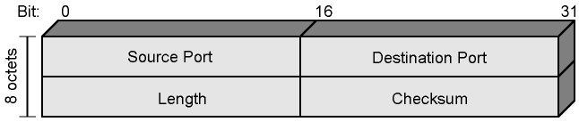
UDP Header

